Slide 1

STEEL FABRICATION ORDER MANAGEMENT SYSTEM
C-DAC ATC NETCOM JAIPUR
Project Presentation
Submitted By:-
Name PNR No
Amol Mote 210930920003
Suyog Chougule 210930920009
Sagar Patil 210930920046
Priyanak Gosavi 210930920039

Slide 2
INTRODUCTION TO PROJECT
The web based “STEEL FABRICATION ORDER MANAGEMENT SYSTEM” project is an attempt to simulate the basic concepts of order management system.

Slide 3
Purpose
Purpose of steel fabrication order management system project is that the system will be used to fulfill the need of people who wants to option for the ordering the steel furniture online.

Slide 4
scope
steel fabrication order management system is web-based application that allows the admin to handle all the activities online quickly.
So, the aim of the project is to provide product to customers.
The customer can choose the products from category and place the order online.

Slide 5
Module
Admin module
Manager module
User or customer module
Delivery Agent Module

Slide 6
Admin module
Sub Module
- View customer
- Add remove staff
- View feedback

Slide 7
Manager module
Sub Module
-Manage products
-Manage delivery
-View feedback
-View order customization

Slide 8
Customer or user module
Sub Module
- View Product
- Making Order
- View Order History
- Registration Module

Slide 9
Delivery Agent Account
Sub Module
-Receive order
-Track order
-Update order status

Slide 10
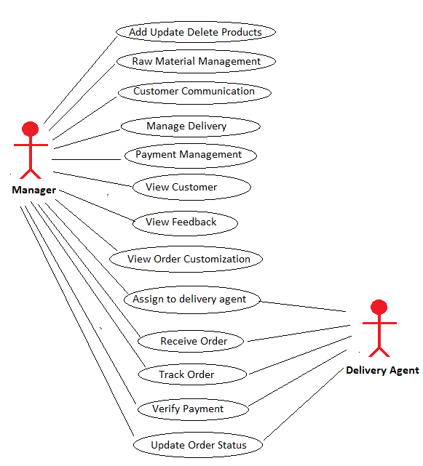
USE CASE DIAGRAM

Slide 11
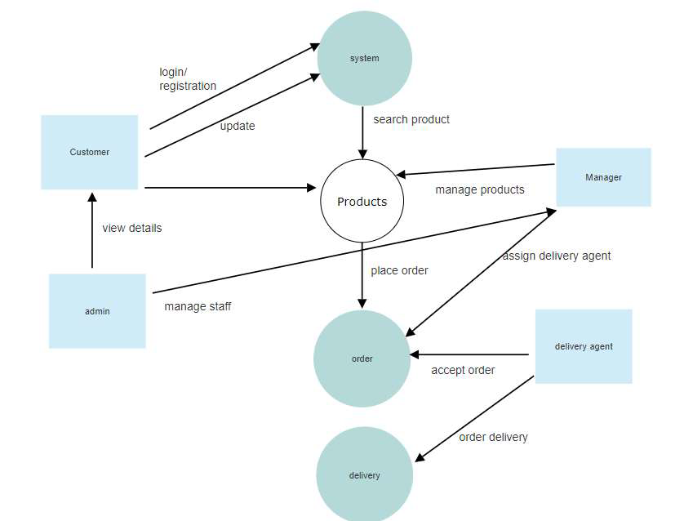
Dataflow Diagram

Slide 12
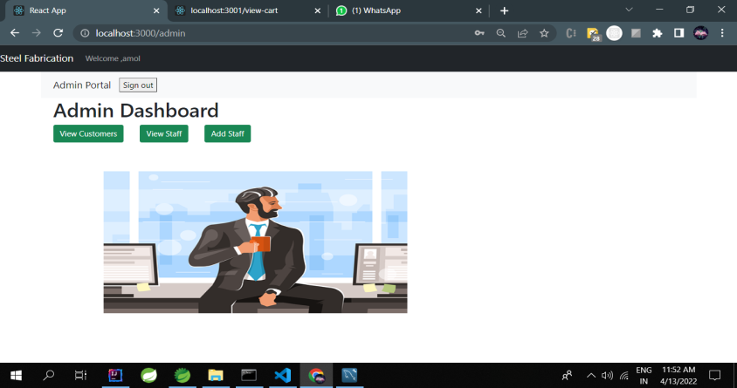
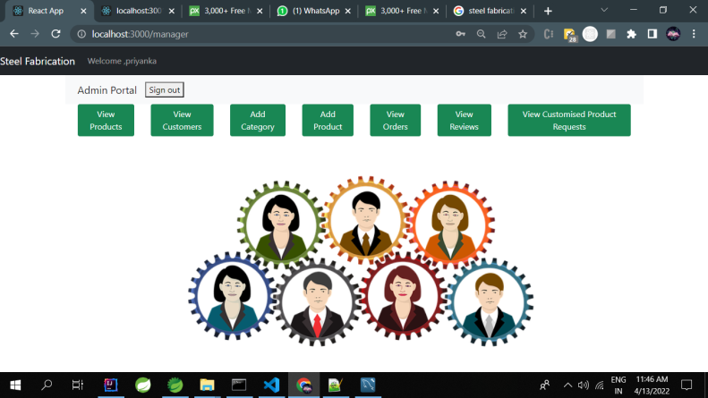
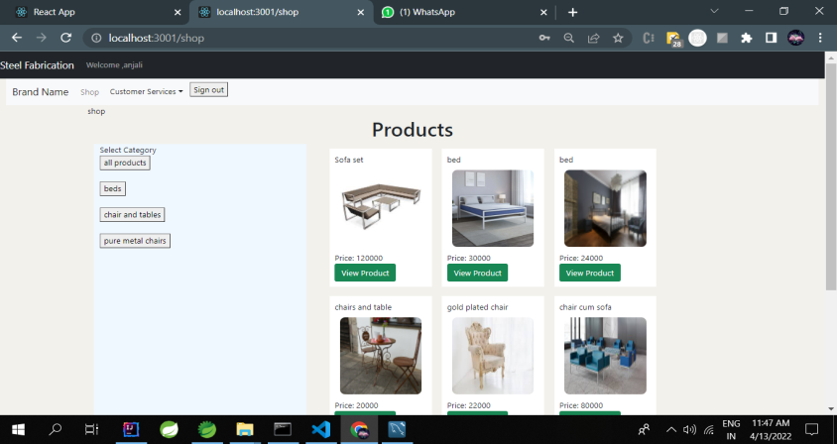
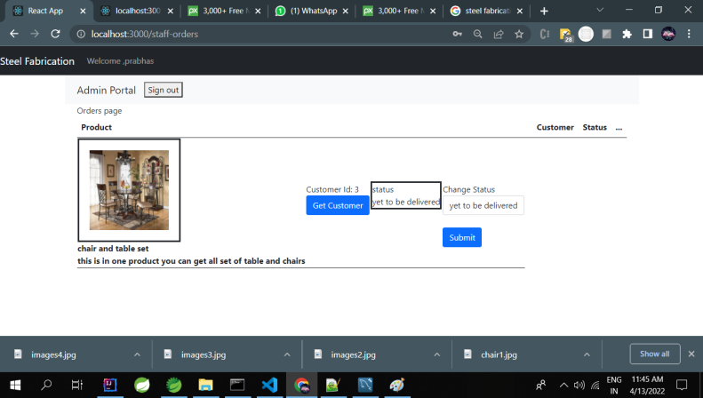
Project Screenshot
Admin
Manager
Customer
Delivery Agent

Slide 13
Future Scope
Online Payment option will be provide in future.
To build Website more User friendly and Secure and dynamic .

Slide 14
REFERENCES
http://www.google.com
https://react-bootstrap.github.io/
https://reactjs.org/docs
https://react-redux.js.org/
https://www.baeldung.com/
http://www.webdevelopersjournal.com/
http://www.w3.org
http://www.wikipedia.org

Slide 15
Thank You !

